Slide 1
COVID-19
Tracking
Eagle-Project1

Slide 2
Introduction
Healthcare Analysts with an interest in the safety of the public.
Magdalena Alvarez
Dariel Ibanez
Christelle Augusma
Mario Loayza

Slide 3
Overview
This project focused on tracking COVID-19 numbers to answer the question around vaccine effectiveness.
COVID-19
Kaggle
Data Take Away

Slide 4
Data Across the US
Cases
Deaths
Florida
California
New York
Texas

Slide 5
Stakeholders
Pharmaceutical Company
CDC Research
Vaccines
COVID-19 Trend

Slide 6
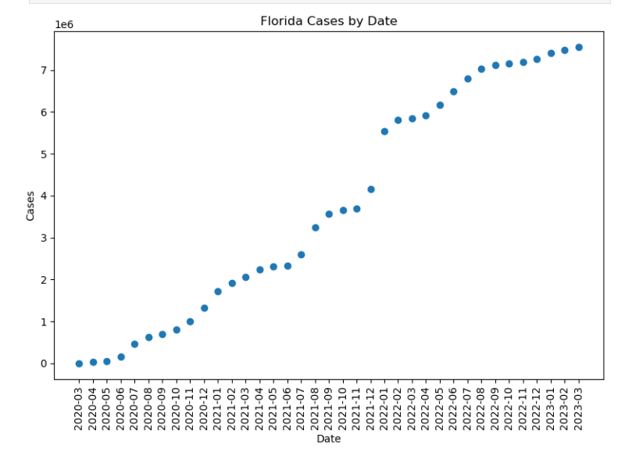

Slide 7
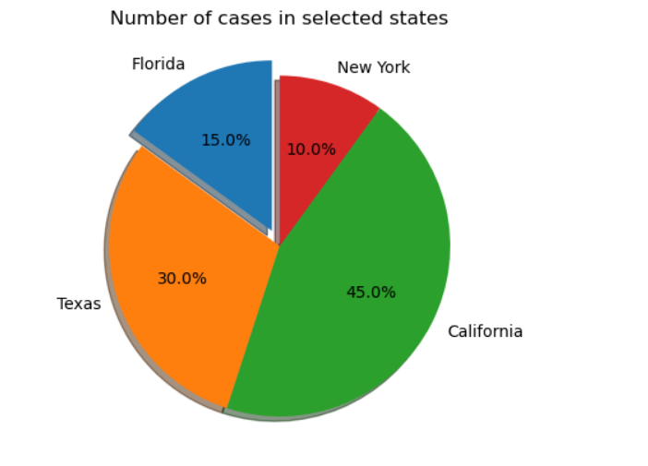

Slide 8
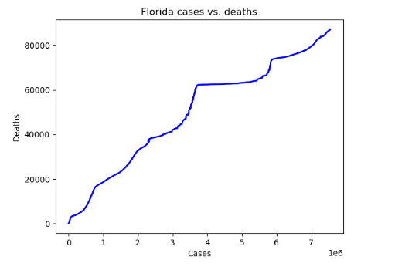

Slide 9
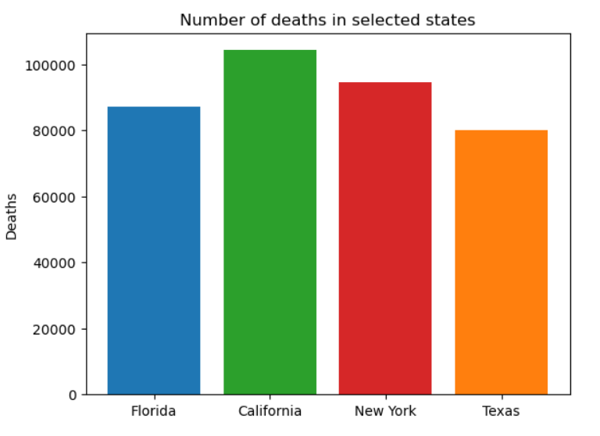

Slide 10
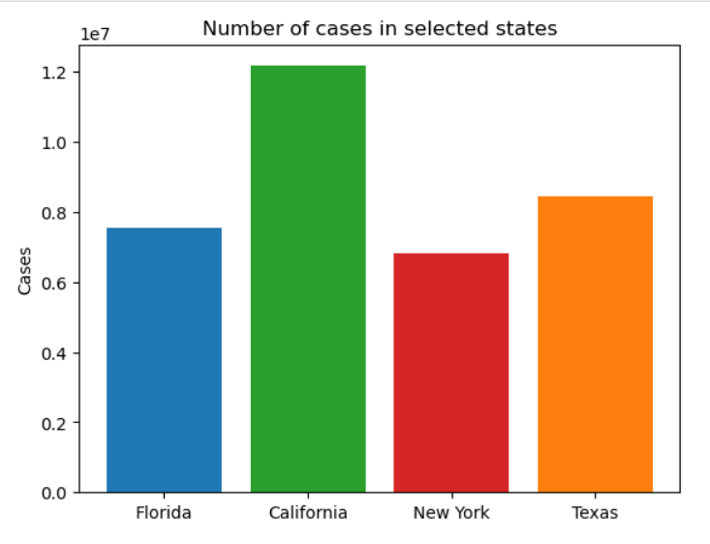

Slide 11
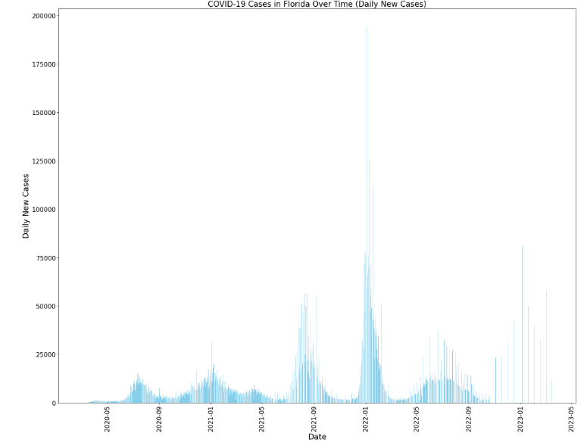

Slide 12
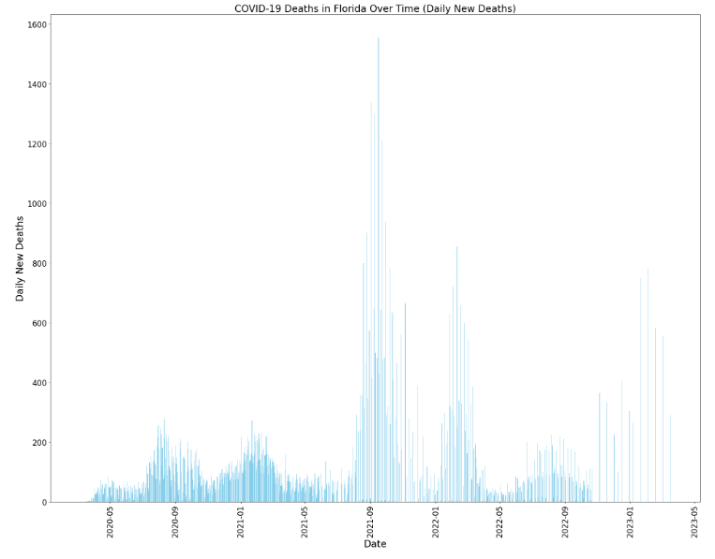

Slide 13
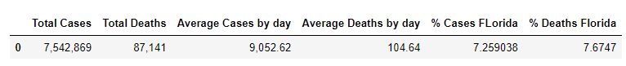

Slide 14
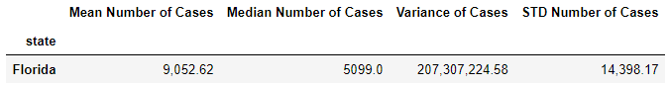
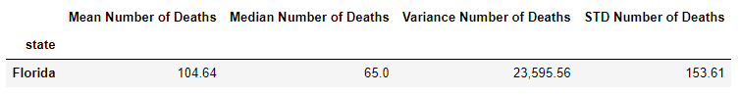
Statistical Analysis

Slide 15
Thank you
Eagle-Project1

